Slide 1

Improvement of the machine learning methods used in Financial Fraud detection
Bennong Liu

Slide 2

Abstract
This research is focused on the AI technology used in Financial Fraud detection, and deep analysis two research associated with. And This study raises two important question:
1.whether the effectiveness of detecting financial fraud improves with the selection of more features in relevant AI models.
2.Consider the change of different time will improve the detection model or not?
The findings indicate that in the XGBOOST model, adding more features beyond a certain point does not lead to better performance. In the sample, the optimal choice is 45 features, including specific key ones, which yield the best results. And considering the change of different time will improve the model performance.

Slide 3
Introduction
Financial fraud is a major global issue, with losses ranging from millions to billions of dollars, such as in the Enron scandal. While traditional rule-based detection methods are limited in handling complex fraud, machine learning (ML) has emerged as a powerful tool, leveraging big data to uncover hidden fraud patterns. A 2024 report presented at the 3rd Jakarta International Conference on Sustainable Economic Development reviewed 24 studies (2014–2023), highlighting AI’s potential in fraud detection, particularly in credit card fraud and financial statement analysis. The focus of the report is on applying ML techniques to detect fraud in China's stock markets, with discussions on model interpretability, research gaps, and the impact of legal changes on model performance. The paper explores whether more features always improve outcomes and includes sections on ML basics, research methods, XGBoost performance, and future research directions.
The structure of this paper is as follows:
Section 2 briefly introduces the basic concepts of machine learning;
Section 3 provides an overview of the research review;
Section 4 describes the methodology adopted in the research papers;
Section 5 compare the two studies and raise some question about the sutdies;
Section 6 discusses future research directions and briefly describe the values and methods. (research gap)
Section 7 the core question: Do more features always lead to better performance?& Legal and Regulatory Changes Impact Model Performance?
Section 8 research method(methodology)
Section 9 data analysis
Section 10 XGBoost performance
Section 11 Conclusion

Slide 4
Machine Learning
Machine learning is a key area of artificial intelligence (AI) that enables computers to gain experience from data, make decisions, or predictions without being explicitly programmed. It relies on algorithms and statistical models to uncover patterns in large datasets, allowing the system to continually improve its performance. Machine learning can be categorized into three main types: supervised learning, where models are trained using labeled data; unsupervised learning, which identifies patterns in unlabeled data; and reinforcement learning, where learning occurs through trial and error via interactions with the environment. This technology has been widely applied in various fields, such as image and speech recognition, recommendation systems, financial fraud detection, and autonomous driving.

Slide 5
overview of the research review: Research Questions of SLR
· RQ1: How can machine learning be utilized to detect financial fraud in China’s major stock markets?
· RQ2: How do these methods perform, and which machine learning models are used?

Slide 6
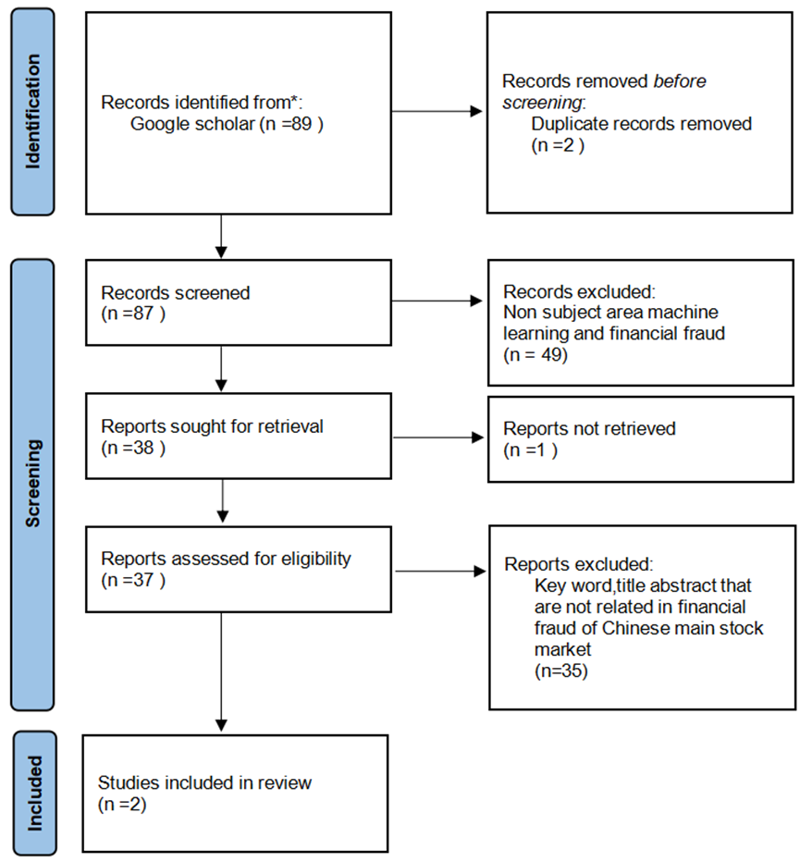
PRISMA overview of the research review: SLR(Systematic Literature Review )

Slide 7
overview of the research review: Analyzing Financial Statement Fraud in Chinese Listed Companies Using Deep Learning
Research Topic: This paper focuses on the use of deep learning techniques to identify and classify financial statement fraud in Chinese-listed companies. The main issue the research specifically addresses is the fact that fraudulent financial reporting, if left unchecked, causes a major economic loss in China and also greatly undermines market credibility. Hence, numerical data are dealt with using the financial statements, and textual data are obtained from the MD&A sections of companies' annual reports. Data analysis through the model will increase the performance of fraud detection systems. It aims at eliminating some of the pitfalls in traditional fraud detection methods that are purely quantitative without the use of textual analysis insights.
Key Findings:
The study revealed several key insights:
An improvement in Accuracy of Detection: Textual data added to numerical financial data has the potential to greatly improve fraud detection. The best models reached classification accuracies of 94.98% and 94.62%, showing that deep learning technologies can also work with great results for this problem.
Importance of Textual Data: Textual features derived from the MD&A section are extremely useful in detecting fraud. It was found that including these features improved the performance of the model in identifying fraudulent firms.
Superiority of Deep Learning Models: The deep learning models, in particular LSTMs and GRUs, outperformed the traditional machine learning models, such as SVM and RF. This is because deep learning better addresses the complexity of financial data, especially when it involves both structured (numerical) and unstructured (textual) information.
Class Imbalance Problem: The presence of having a class imbalance in its dataset, where the number of non-fraudulent firms is very high compared to the fraudulent firms, was dealt with. Data balancing techniques and the use of specialized loss functions, such as Focal Loss, were employed to mitigate this problem so that they could improve on the ability of the model to detect the minority class (fraud cases).
Advantages of Combined Models: Combined models of financial and textual data outperformed models using only one data type. These ensemble models also had better performance in terms of AUC and F2 scores, which showed that the multimodal approach has a more favorable position in financial fraud detection.
Conclusion
In this research study, a comprehensive model was developed to predict and prevent corporate fraud in China. The developed model used five dimensions with 26 features that relate to different types of fraud and indicators. SMOTE pre-processing is applied before training the model. The classifier is trained through the Logistic Regression technique, Support Vector Machines, XGBoost, GAN with auto-encoder, and One-Class SVM using five machine learning techniques. The highest accuracy belonged to XGBoost, and the most efficient in loss reduction in a misclassification environment seemed to be GAN using an auto-encoder. Salient features that determine fraud are Financial Leverage, Net Profit, and Total Leverage. The model sensitivity to fraud patterns shows potential for regulatory bodies like CSRC to enhance financial audit processes. It also has a much wider application in the field of risk management and company and investor financial analysis.

Slide 8
overview of the research review: Chinese corporate fraud risk assessment with machine learning
Research Topic: The most critical issue currently facing China's financial market is corporate internal fraud detection. With the capital markets having become the most rapidly growing sector in China, corporate fraud also grows in numbers, which has greatly caused harm to investors' confidence and undermined market stability. The aim is to be able to design a holistic model of machine learning that would be capable of making an accurate assessment and recalibration of the probability of corporate fraud. This research intends to design an early warning system that should be handy for financial institutions and regulatory bodies, like the China Securities Regulatory Commission, to spot any potential fraud before it becomes systemic in nature.
Key Finding:
The study revealed several key insights:
Model Performance: XGBoost outperformed the other models across metrics such as accuracy, AUC, and F1 score. Its ability to identify complex patterns related to corporate fraud made it an excellent choice for practical applications.
GAN and Autoencoder: These models presented the highest sensitivity, being able to capture fraud cases. However, their low specificity and overall accuracy showed a high level of false positives compared to some other models.
Logistic Regression, SVM, and OC-SVM: These models gave a moderate response. Although they provided quite high accuracy and AUC, their sensitivity was relatively lower compared with XGBoost and GAN, making them less effective in capturing all cases of fraud.
Conclusion
In this research study, a comprehensive model was developed to predict and prevent corporate fraud in China. The developed model used five dimensions with 26 features that relate to different types of fraud and indicators. SMOTE pre-processing is applied before training the model. The classifier is trained through the Logistic Regression technique, Support Vector Machines, XGBoost, GAN with auto-encoder, and One-Class SVM using five machine learning techniques. The highest accuracy belonged to XGBoost, and the most efficient in loss reduction in a misclassification environment seemed to be GAN using an auto-encoder. Salient features that determine fraud are Financial Leverage, Net Profit, and Total Leverage. The model sensitivity to fraud patterns shows potential for regulatory bodies like CSRC to enhance financial audit processes. It also has a much wider application in the field of risk management and company and investor financial analysis.

Slide 9
compare the two studies and raise some question about the studies(Research gap)
Does More Features Always Lead to Better Performance?
Does increasing the number of features genuinely improve the model’s performance? If a similarly comprehensive pool of candidate features is used, would the increase in features enable deep learning to outperform XGBoost, which achieved the best result after feature selection?
Predicting Future Scenarios is More Important than Fitting Past Data: In real-world scenarios, the most important aspect of detecting financial fraud is not just fitting past data but predicting future fraud. Can the fraud detection models, trained on past data, still maintain a high level of accuracy and predictive performance in future scenarios, rather than just overfitting to historical cases?
Legal and Regulatory Changes Impact Model Performance:
As legal regulations regarding financial fraud penalties may change over time, should training samples be divided according to different time periods and regulations, and then trained separately? Would such an approach better reflect real-world business scenarios and provide more practical value? In such a case, how would the model's performance change? Would it become more effective or less?

Slide 10
Does More Features Always Lead to Better Performance? &Legal and Regulatory Changes Impact Model Performance? Research method(methodology)
This study Outlines a comprehensive approach to corporate fraud detection that utilizes a variety of machine learning algorithms. The dataset, derived from the CSMAR public database, covers the period from 2013 to 2018 and contains a total of 46,517 initial observations. The 45 explanatory variables were carefully selected around five main dimensions: financial position, financial metrics, share transfer, regulation, and management change.
In order to model the algorithm, a number of steps are performed in the data preprocessing process, including:
Remove observations with missing values;
Fill (interpolate) the remaining missing data;
Apply the synthetic minority class oversampling technique (SMOTE) to solve the class imbalance problem.
0/1 processing for partial features
Industry neutrality: some features are neutralized to form new features to be added to the data set
Remove four columns of non-feature data, such as citics, windcode, name, Report_period
Statistical analysis including mean, standard deviation and feature correlation was performed to evaluate the validity of the selected variables. The processed data sets were randomly shuffled and divided into training sets and test sets in an 80:20 ratio.
This research focuses on machine learning algorithms using extreme gradient Boost (XGBoost).
The research results are analyzed and compared from the perspective of recall rate, accuracy rate and ROC-AUC, and the characteristics are analyzed and sorted by gain analysis method, and the research conclusion is finally drawn.

Slide 11
Data analysis(research method)
Ma (2018) classifies Chinese corporate fraud into four categories: ** false disclosure, concealed disclosure, delayed disclosure, and illegal transactions. In this study, fraud labels were selected from a database called CSRC's Enforcement Actions.
When choosing features, five dimensions were taken into consideration. They are:
1. Financial status:
Financial conditions are directly related to certain types of fraud, such as false profits, false assets, and general accounting mishandling. At the same time, it can reflect the financial health of the company.
2. Financial indicators:
Financial indicators are statistical data based on the financial characteristics of the company, which can reflect the potential risk level of the company. Institutional ownership is classified as this dimension, and it is widely used in stock trading. With expertise and tools, institutional investors may be able to spot potential fraud before other players in the market.
3. Share transfer:
Share transfers are directly linked to certain types of fraud, such as insider trading, illegal stock trading, and stock price manipulation. In addition, powerful shareholders may try to sell shares before the fraud is exposed.
4. Supervision:
Companies that are rigorously audited are less likely to commit fraud.
5. Management changes:
Managers may be liable for corporate fraud. As a result, changes in management can be associated with fraud, especially when managers leave for crimes.
Based on these five dimensions, a total of 45 features were selected. The eigenvalues are trained after min-max normalization, without discretization.

Slide 12
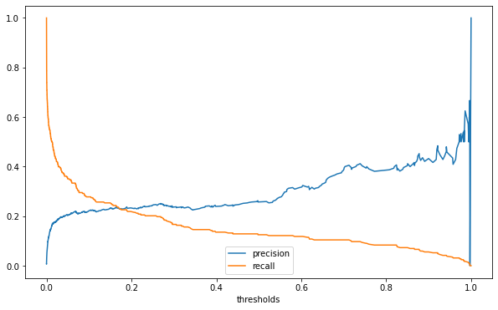
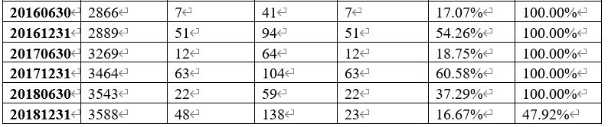
Results and discussion
ROC-AUC
The ROC-AUC value of the model can reach 0.8795, which indicates that the model has good effect and high prediction accuracy, and can play a certain role and value in the actual problem analysis.
Accuracy and recall
When the classification threshold is 0.01, the prediction results of from the 2016 semi-annual report to 2018 annual report are calculated and screened

Slide 13
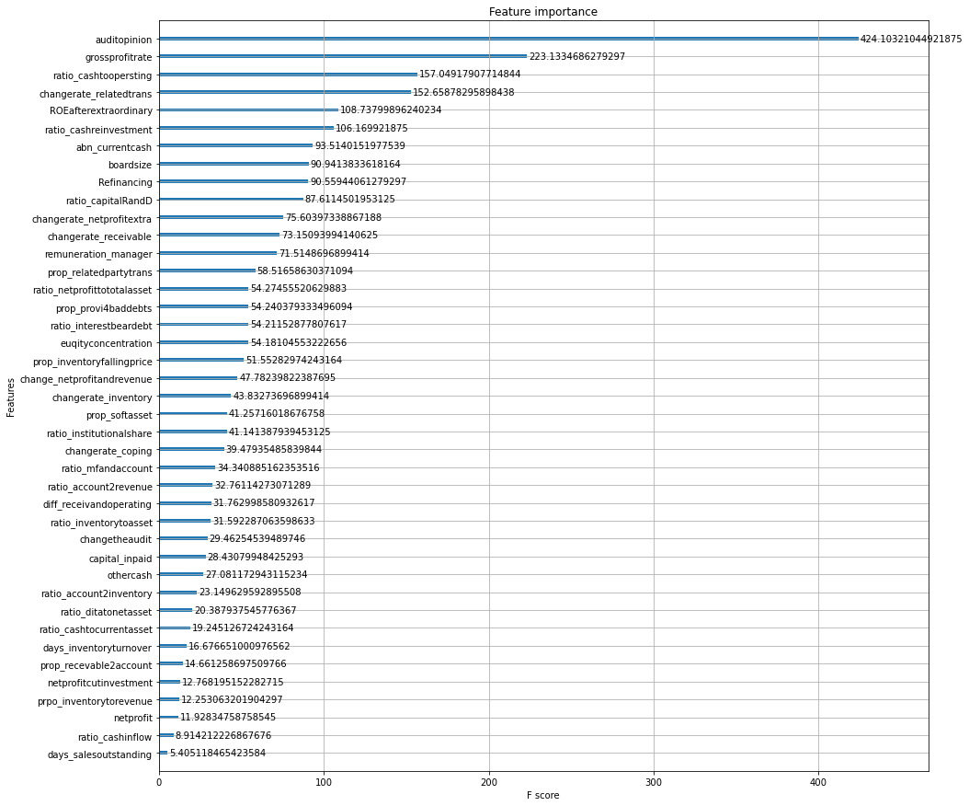
Feature importance
This model uses gain for feature importance analysis, and the results are shown in the figure right.

Slide 14
Time dimension improvement
Statistical table of test set prediction results
Report_period | count | Fake numbers | Label number | Right label | precision | recall
20130630 | 496 | 1 | 4 | 0 | 0.000 | 0.000
20131231 | 496 | 3 | 16 | 2 | 0.125 | 0.667
20140630 | 1263 | 1 | 15 | 0 | 0.000 | 0.000
20141231 | 516 | 4 | 16 | 3 | 0.187 | 0.750
20150630 | 549 | 1 | 7 | 1 | 0.143 | 1.000
20151231 | 558 | 7 | 22 | 5 | 0.227 | 0.714
20160630 | 572 | 1 | 9 | 1 | 0.111 | 1.000
20161231 | 577 | 10 | 27 | 8 | 0.296 | 0.800
20170630 | 653 | 2 | 13 | 1 | 0.077 | 0.500
20171231 | 692 | 12 | 25 | 9 | 0.360 | 0.750
20180630 | 708 | 4 | 11 | 2 | 0.182 | 0.500
20181231 | 717 | 9 | 21 | 6 | 0.286 | 0.667
Statistical table of overall sample prediction results
Report_period | count | Fake numbers | Label number | Right label | precision | recall
20130630 | 2482 | 5 | 17 | 4 | 0.235 | 0.800
20131231 | 2480 | 15 | 37 | 14 | 0.378 | 0.933
20140630 | 2526 | 2 | 22 | 1 | 0.045 | 0.500
20141231 | 2584 | 21 | 52 | 20 | 0.385 | 0.953
20150630 | 2746 | 6 | 31 | 6 | 0.193 | 1.000
20151231 | 2794 | 35 | 72 | 33 | 0.458 | 0.943
20160630 | 2866 | 7 | 30 | 7 | 0.233 | 1.000
20161231 | 2889 | 51 | 86 | 49 | 0.570 | 0.961
20170630 | 3269 | 12 | 46 | 11 | 0.239 | 0.917
20171231 | 3464 | 63 | 105 | 60 | 0.571 | 0.952
20180630 | 3543 | 22 | 55 | 20 | 0.363 | 0.909
20181231 | 3588 | 48 | 92 | 45 | 0.489 | 0.937

Slide 15
Use industry neutrality to add more data dimensions
feature | style
days_salesoutstanding | Classification feature
change_netprofitandrevenue | Classification feature
changetheaudit | Classification feature
prpo_inventorytorevenu | Numerical feature
netprofitcutinvestment | Numerical feature
ratio_cashinflow | Numerical feature
ratio_cashtocurrentasset | Numerical feature
days_inventoryturnover | Numerical feature
ROC-AUC
The ROC-AUC value of the original XGBoost model on the test set is 0.9607, and the ROC-AUC value of the industry-centralized model on the test set is 0.9566, which is slightly decreased.
Accuracy and recall
When the classification threshold is 0.01, the accuracy and recall rates of the original XGBoost model on the test set are 0.1662 and 0.6123, and the accuracy and recall rates on all samples are 0.3468 and 0.9004. The accuracy and recall rates of the model after industry centralization are 0.1580 and 0.6413 on the test set, and 0.3202 and 0.9059 on the whole sample, respectively.
Compared with the original model, when the classification threshold of the industry centralized model is 0.01, the accuracy rate has a small decline, and the recall rate has a small increase.

Slide 16

conclusion
Block training according to time dimension can improve model performance.
More data does not mean better model performance and requires specific experimentation with data content and training goals.

Slide 17

Contribution
This study fills in the gaps and shortcomings of previous studies. This study fills gaps in existing research and provides new insights in the following areas:
The importance of feature optimization and selection: The study deeply discussed the influence of different feature numbers on model performance,and found that the increase in the number of features limited the improvement of model effect after a certain threshold, which provided clear guidance for the reasonable selection of features in financial fraud detection.
Time dimension and model improvement: This paper proposes a time-based piecewise training method, which effectively reduces the overfitting phenomenon of the model and improves the prediction ability on the data of different time periods.
Innovation in industry-neutral treatment: By eliminating the influence of industry factors, the model behaves more universally. This method provides a reference for fraud detection applications in different markets and industries.
Processing of unbalanced data: Using SMOTE and other techniques to deal with the imbalance between fraudulent and non-fraudulent samples significantly improved the model's ability to identify a small number of fraudulent samples.

Slide 18
Conclusion
This study focuses on the financial fraud detection of Chinese listed companies, focuses on the effects of different machine learning models, and proposes several key findings and improvement strategies:
The relationship between the number of features and model performance: Studies show that in XGBoost model, increasing the number of features does not always improve the performance; After a certain characteristic threshold is exceeded, the model effect tends to be stable or even decline. Therefore, reasonable selection of important features is very important to improve the performance of the model.
The importance of the time dimension: The overfitting problem of the model was solved by training and testing based on time segments. This indicates that the design of the model should fully consider the time characteristics of data and the dynamic changes of the market environment.
Comparative analysis of machine learning models: XGBoost performed best in this study, especially when dealing with large-scale data and complex patterns. Compared to models such as GAN and autoencoders, XGBoost offers significant advantages in terms of balance accuracy and recall.
Industry neutrality and universality: Industry neutrality reduces the interference of industry factors on model predictions, making the application performance of the model in different markets more stable. This approach also has important implications for model development in other financial fields.
Future research directions and challenges: This study suggests further exploration of the introduction of real-time data, such as company announcements and social media sentiment data, to improve the predictive power of the model. In addition, changes in different regulations and market conditions may affect the performance of the model, and it is necessary to improve the adaptability of the model through multi-time period data training.

Slide 19

Thank you

